Slide 1
SIT323 Practical Software Development
Class 6 – Cloud Programming

Slide 2
Content
Azure http://portal.azure.com
Accounts
Dashboard
Billing
Resource Groups
Virtual Machines
Creation
Demo
SIT323 - Deakin University - 2019
Page 2

Slide 3
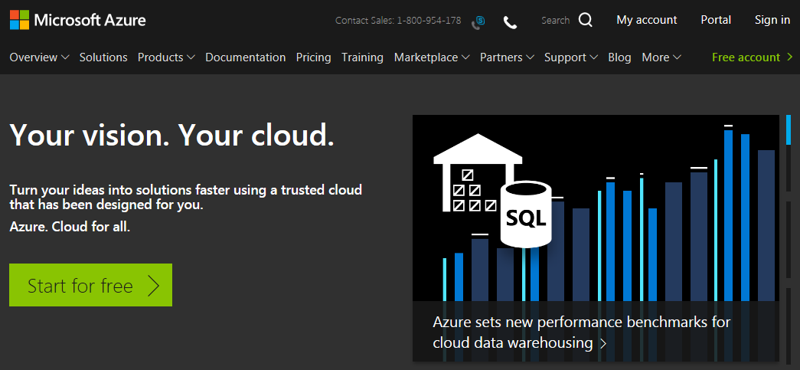
Azure Accounts – Free
Free accounts are available from Azure
https://azure.microsoft.com/en-au/
SIT323 - Deakin University - 2019
Page 3

Slide 4
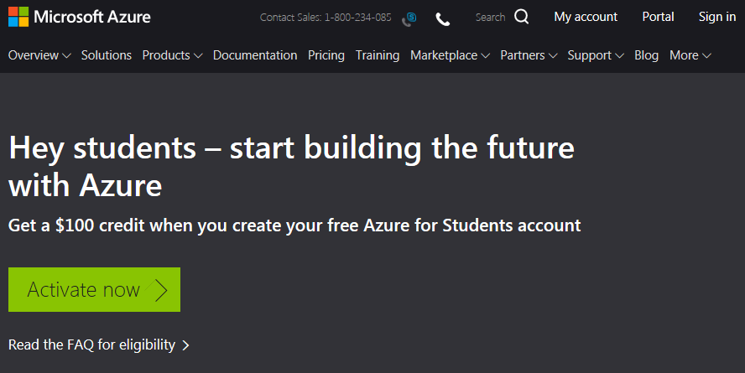
Azure Accounts – Free
Free student-accounts are available from Azure
https://azure.microsoft.com/en-au/free/students/
SIT323 - Deakin University - 2019
Page 4

Slide 5
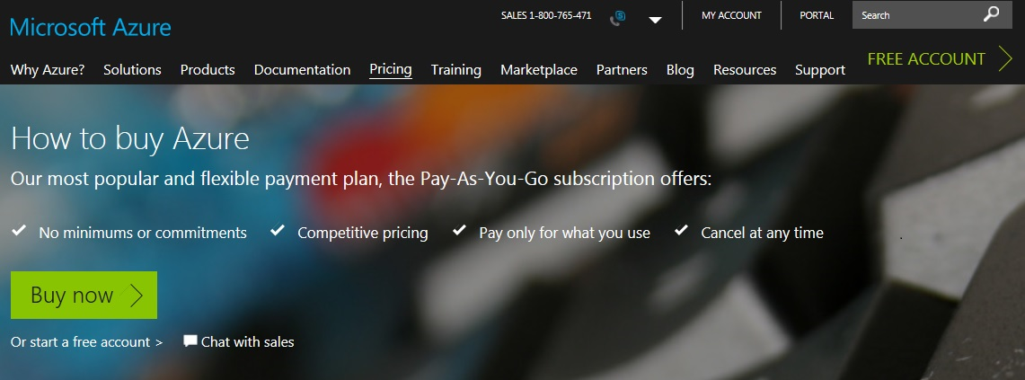
Azure Accounts – Pay As You Go
Also, non-free accounts are available from Azure.
https://azure.microsoft.com/en-au/pricing/purchase-options/
I created an Azure account using my outlook account: robertdew@outlook.com.au
Provided details: Personal, Email, Phone, Credit card, Etc.
SIT323 - Deakin University - 2019
Page 5

Slide 6
Azure Portal
http://portal.azure.com/
This is where you can login.
After login, many resources are available such as:
a dashboard
billing accounts, and subscriptions
resource groups
virtual machines
and many more
SIT323 - Deakin University - 2019
Page 6

Slide 7
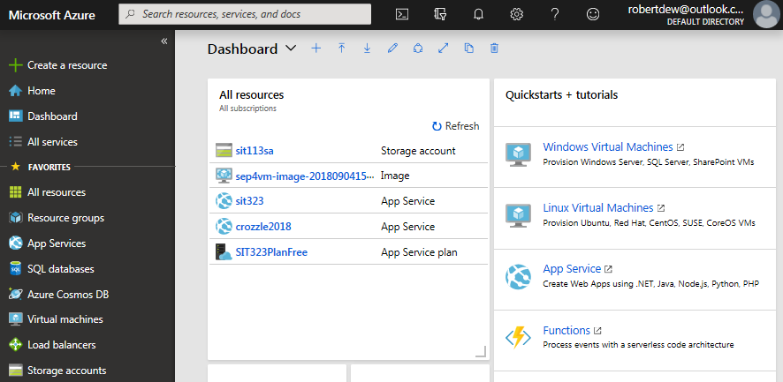
Azure Dashboard
SIT323 - Deakin University - 2019
Page 7

Slide 8
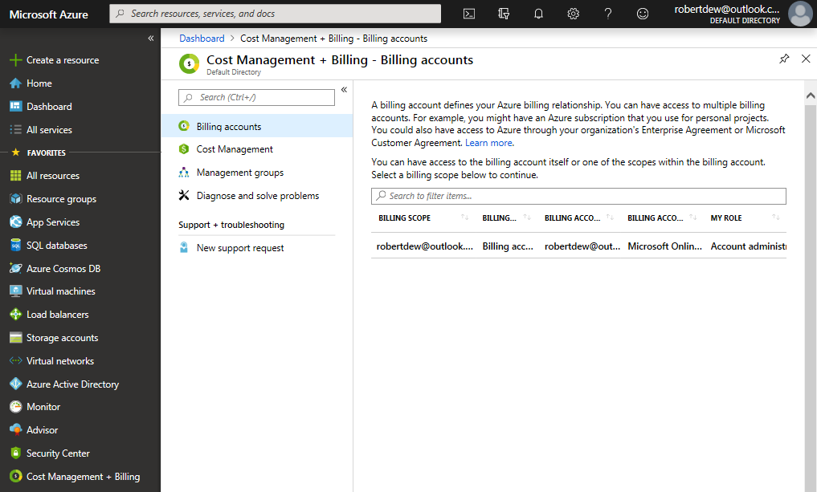
Billing Accounts
A user can have multiple billing accounts.
Robert just has 1 as indicated below, but you use this to access subscriptions.
SIT323 - Deakin University - 2019
Page 8

Slide 9
Subscriptions
A user can have multiple subscriptions to pay for using Azure resources. For example,
A subscription to pay for personal usage.
Another to pay for work activities.
The following slide shows that Robert has 2 subscriptions:
Microsoft Imagine (some resources for free)
Pay-As-You-Go
SIT323 - Deakin University - 2019
Page 9

Slide 10
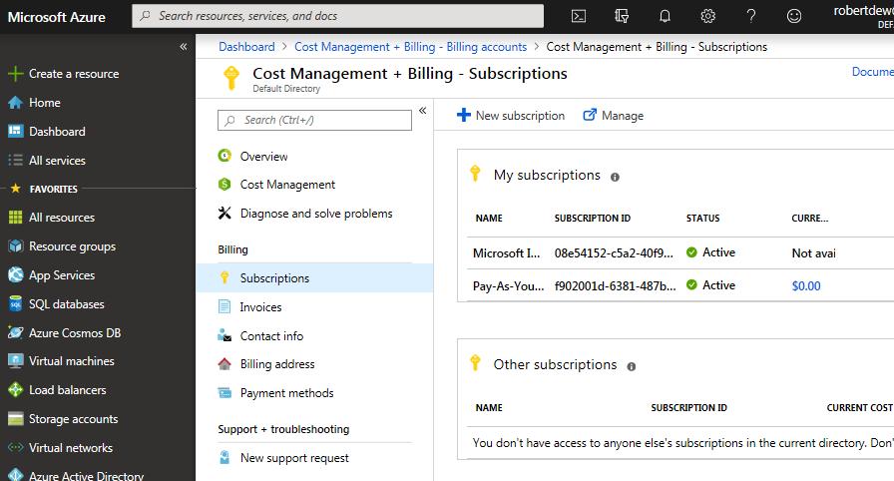
Subscriptions
Create a new subscription here.
SIT323 - Deakin University - 2019
Page 10

Slide 11
Resource Groups
to group related resources together
to deploy, manage, and maintain such resources as a single entity
to grant others access to those resources
SIT323 - Deakin University - 2019
Page 11

Slide 12
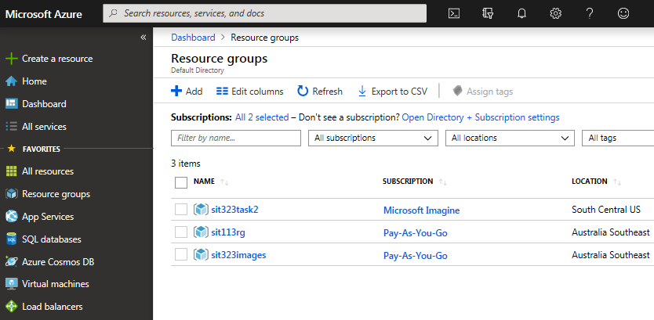
Resource Groups
Create a new resource group here.
SIT323 - Deakin University - 2019
Page 12

Slide 13
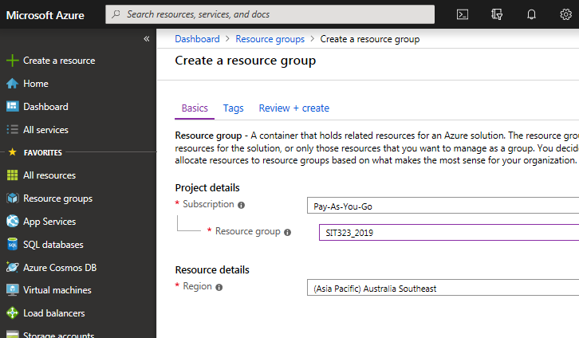
Adding a New Resource Group
Select a subscription, resource group, and region.
SIT323 - Deakin University - 2019
Page 13

Slide 14
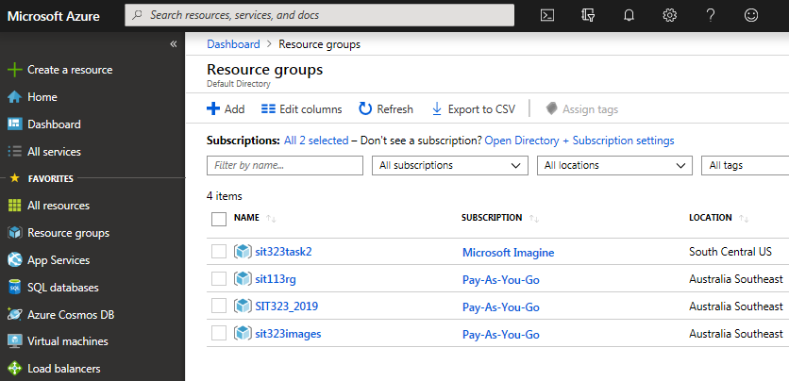
Adding a New Resource Group
Here is the new resource group.
SIT323 - Deakin University - 2019
Page 14

Slide 15
Virtual Machines
choose a VM for more control of the infrastructure
you don’t buy and maintain the physical hardware
you still need to manage software such as configure, patch, install
a snapshot of that VM can be created, i.e., a backup of the VM can be created, and later used to resume that VM
SIT323 - Deakin University - 2019
Page 15

Slide 16
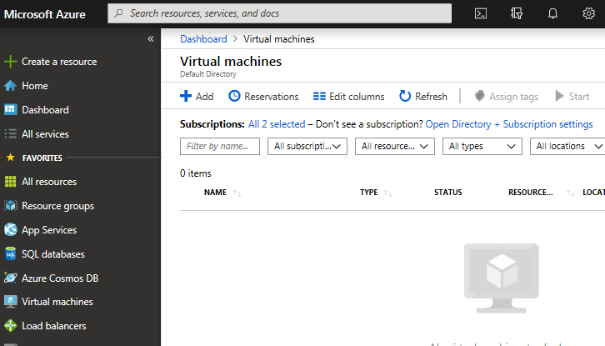
Virtual Machines - Creation
Create a new VM here.
Robert has no virtual machines.
SIT323 - Deakin University - 2019
Page 16

Slide 17
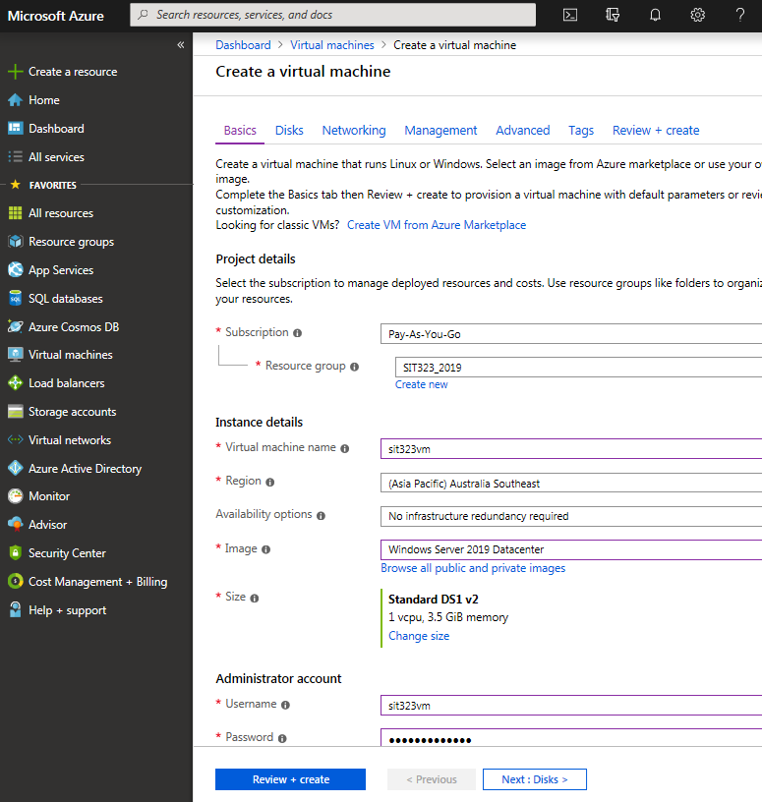
Virtual Machines - Creation
Many options are available to configure your VM.
Many VMs to choose from, e.g., Windows Server.
Deployed in about 4 minutes.
SIT323 - Deakin University - 2019
Page 17

Slide 18
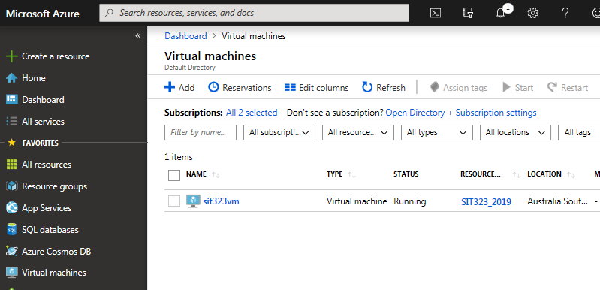
Virtual Machines – sit323vm
Here is a link to the new VM that is running in Southeast Australia.
SIT323 - Deakin University - 2019
Page 18

Slide 19
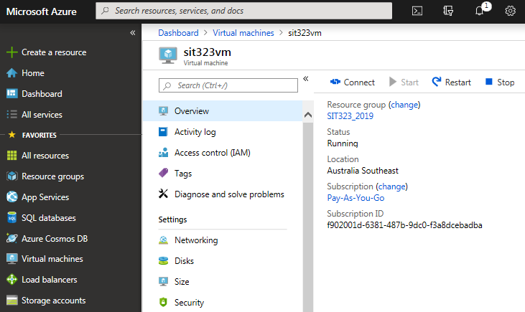
Virtual Machines – Logon
Select the “Connect” button to start the login procedure.
SIT323 - Deakin University - 2019
Page 19

Slide 20
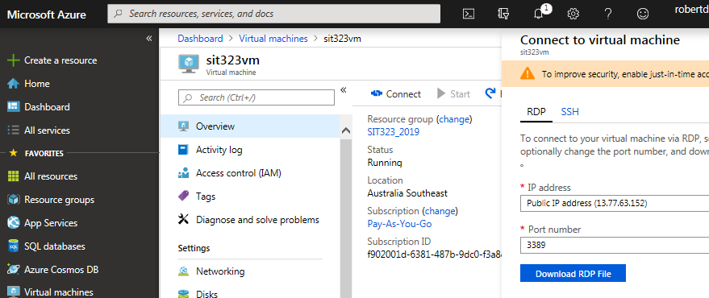
Virtual Machines – Logon
SIT323 - Deakin University - 2019
Page 20

Slide 21
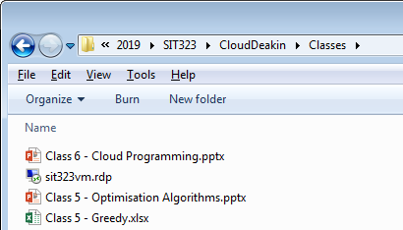
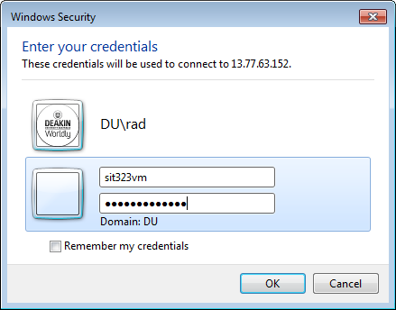
Virtual Machines – Logon
Double Click on the RDP file to obtain the Login Dialog.
SIT323 - Deakin University - 2019
Page 21

Slide 22
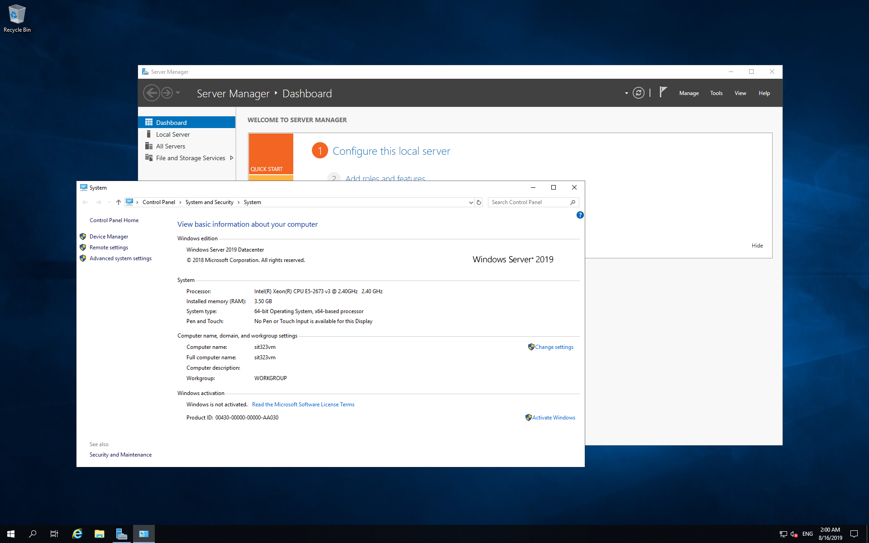
sit323vm – Remote Desktop
Here is a screen snapshot of the 2019 Datacentre VM.
SIT323 - Deakin University - 2019
Page 22

Slide 23
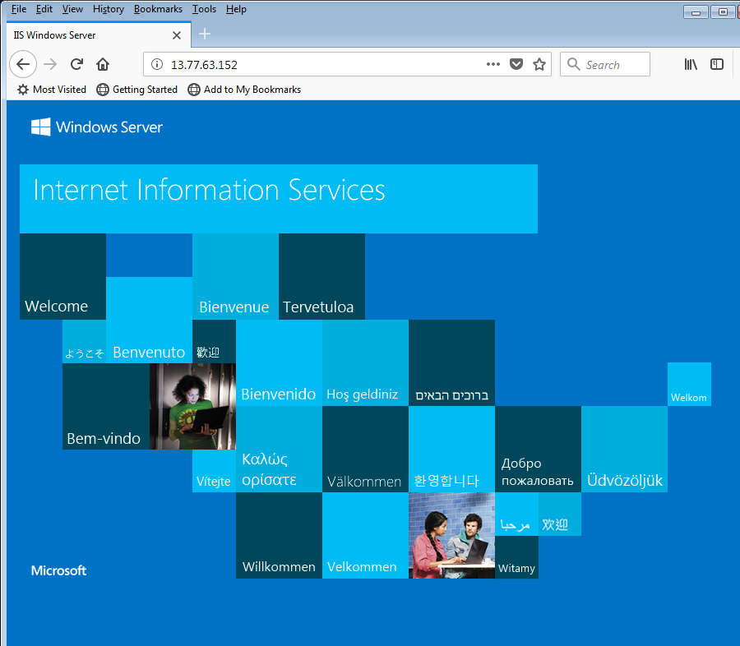
VM Demonstration
http://portal.azure.com/
Create VM
Login to VM
Install IIS
Browse to the default website on VM
SIT323 - Deakin University - 2019
Page 23

Slide 24
Summary
Azure http://portal.azure.com
Accounts
Dashboard
Billing
Resource Groups
Virtual Machines
Creation
Demo
SIT323 - Deakin University - 2019
Page 24

